Slide 1

Exploratory Data Analysis
G2M Insight for Cab Investment
October 16, 2022

Slide 2

Agenda
Executive Summary
Problem Statement
Approach
EDA
EDA Summary
Recommendations

Slide 3
Executive Summary
Purpose: Determine which cab company to invest in
Methods: Compare Yellow Cab and Pink Cab profits, losses, customer demographics, and transactions over time
Timeline: XYZ Company has resources t invest in Yellow or Pink Cab immediately
Results: Significant differences between Yellow and Pink Cab

Slide 4
Problem Statement
XYZ is a private American company
Cab industry has grown in the US over the last few years
XYZ ready to invest in a cab company
Which company is a better investment?

Slide 5
Approach
4 data files used:
Cab (359,392 transactions)
City (20 US cities with population and total number of cab users)
Customer (49,171 customers with demographic information)
Transaction (440,098 rows linking each transaction to customer data)

Slide 6
Approach
3 years time frame (January 31, 2016 to December 31, 2018)
No duplicates or missing values present
Compare profit (price charged minus cost of trip)
Compare user demographics of both companies
Compare transactions and seasonality

Slide 7
The 2 companies have similar gender distributions among customers…

Slide 8
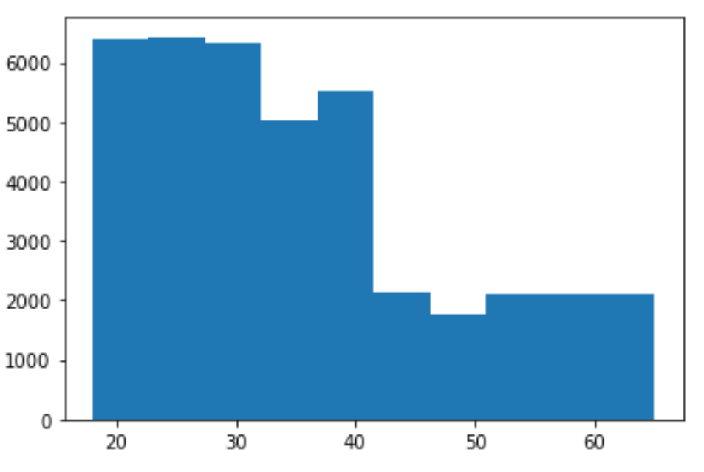
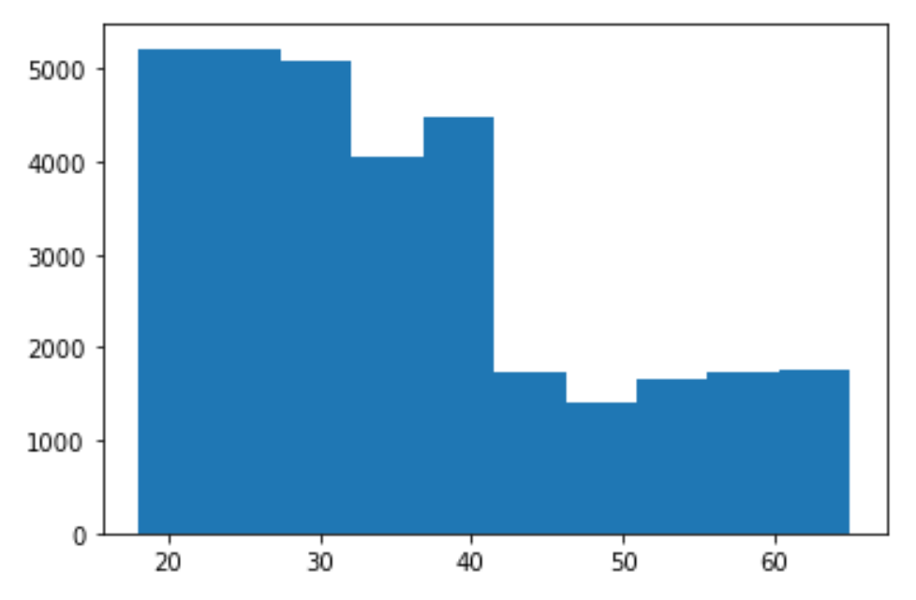
… and similar age distributions among customers, with both skewing young (average age = 35 years for both).
Yellow Cab customer age distribution Pink Cab customer age distribution
Number of customers
Number of customers
Customer age (years)
Customer age (years)

Slide 9
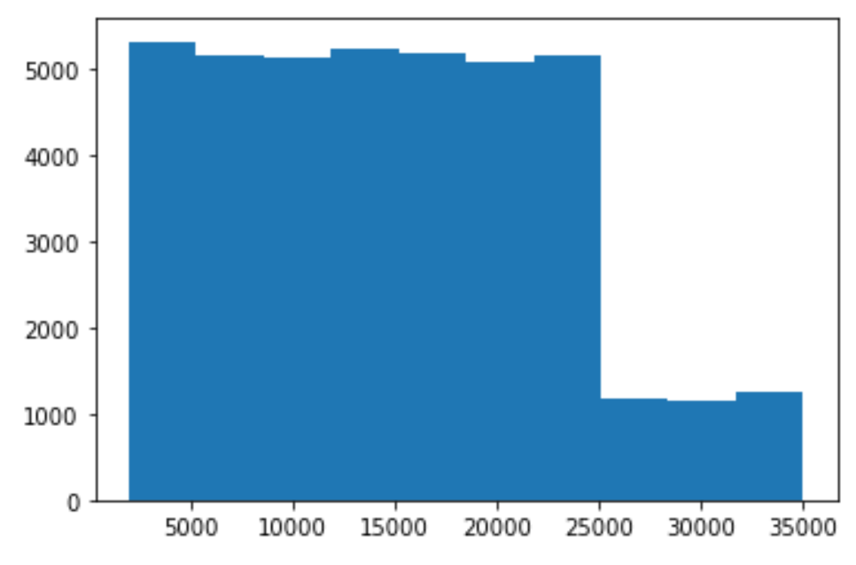
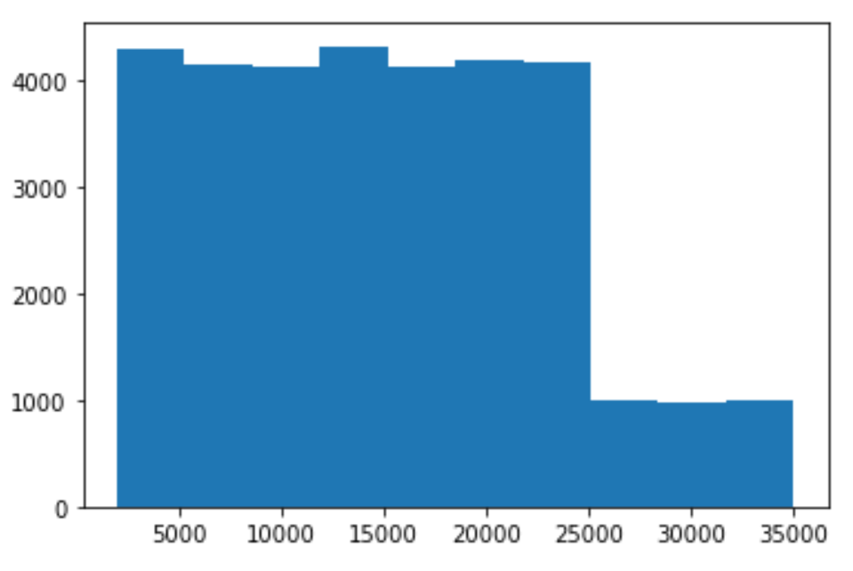
Customer income distribution is also similar between the two companies. Median income is very high ($14,600 per month).
Yellow Cab customer income distribution Pink Cab customer income distribution
Number of customers
Number of customers
Income ($ per month)
Income ($ per month)

Slide 10
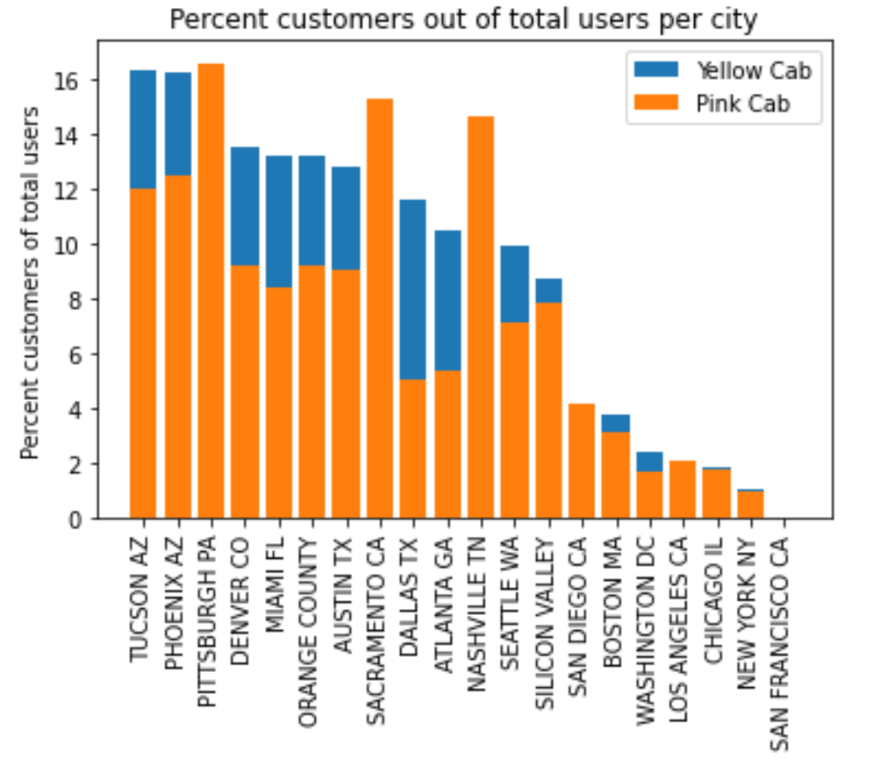
Despite similar customer demographics, Yellow Cab has better market penetration in almost all markets.
Yellow Cab leads in 14 of 19 markets, including 6 of the 10 top cab markets in the US.
Pink Cab leads in Pittsburgh, Sacramento, Nashville, San Diego, and Los Angeles.
Both companies have room to expand. Top market penetration is around 16% of total users.
Neither company is yet in San Francisco, one of the top two cab markets in the US.

Slide 11
96% of Yellow Cab’s customers repeat. Only 83% of Pink Cab’s customers repeat.

Slide 12
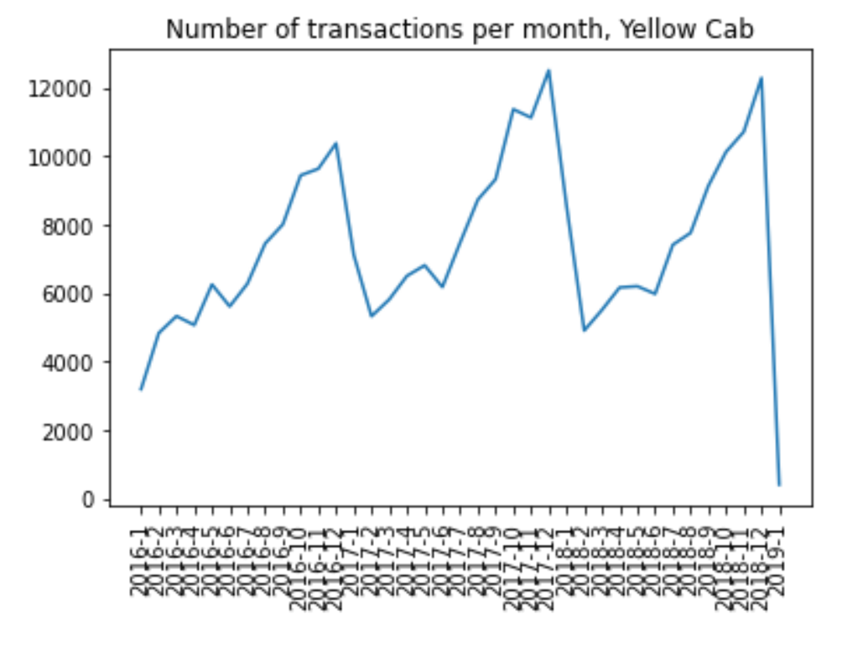
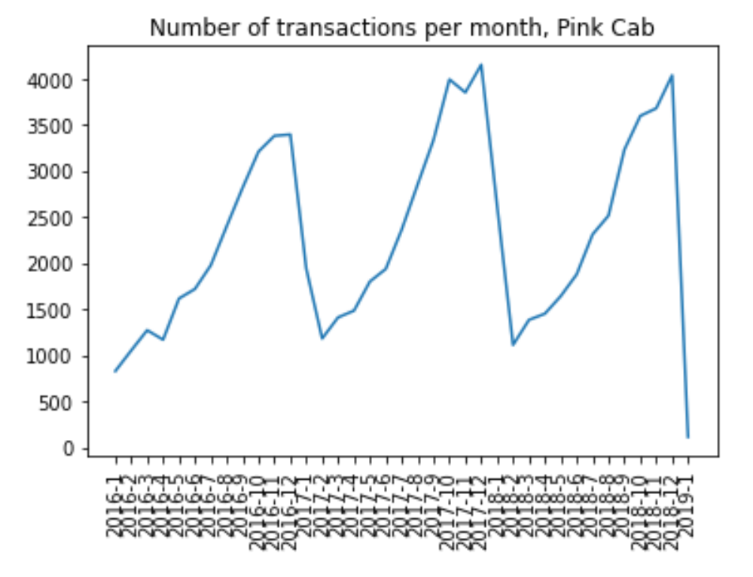
Both companies exhibit a seasonal cycle…

Slide 13
… but Yellow Cab takes more trips and is more profitable per trip.
COMPANY | TOTAL NUMBER OF TRIPS | AVERAGE DISTANCE (KM) PER TRIP | AVERAGE PRICE CHARGED PER TRIP | AVERAGE COST PER TRIP | AVERAGE PROFIT PER TRIP
Yellow Cab | 274,681 | 22.6 | $ 458.18 | $ 297.29 | $ 160.26
Pink Cab | 84,711 | 22.6 | $ 310.80 | $ 248.15 | $ 62.65

Slide 14
95% of Yellow Cab’s trips are profitable. Only 87% of Pink Cab’s are profitable.

Slide 15
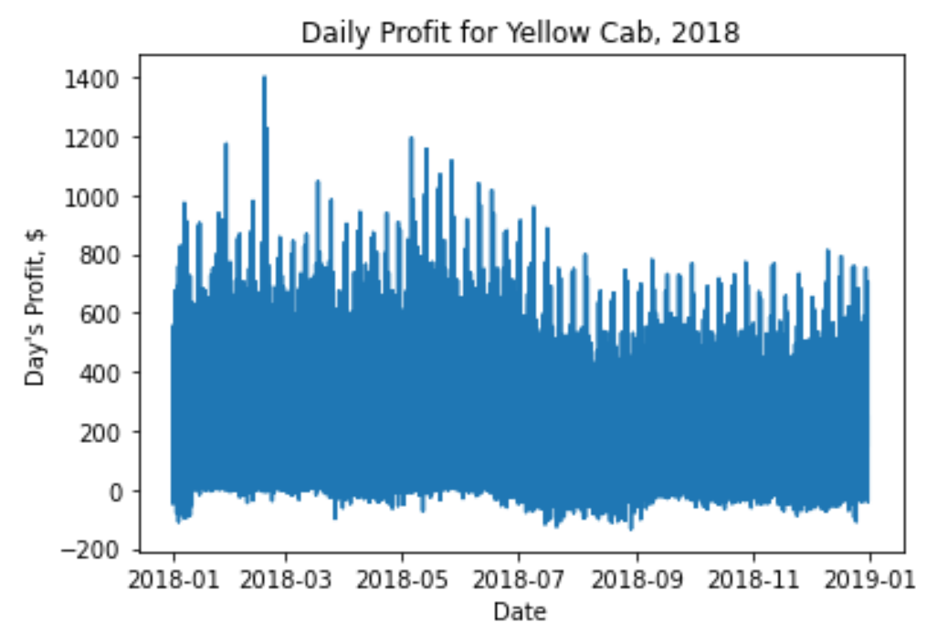
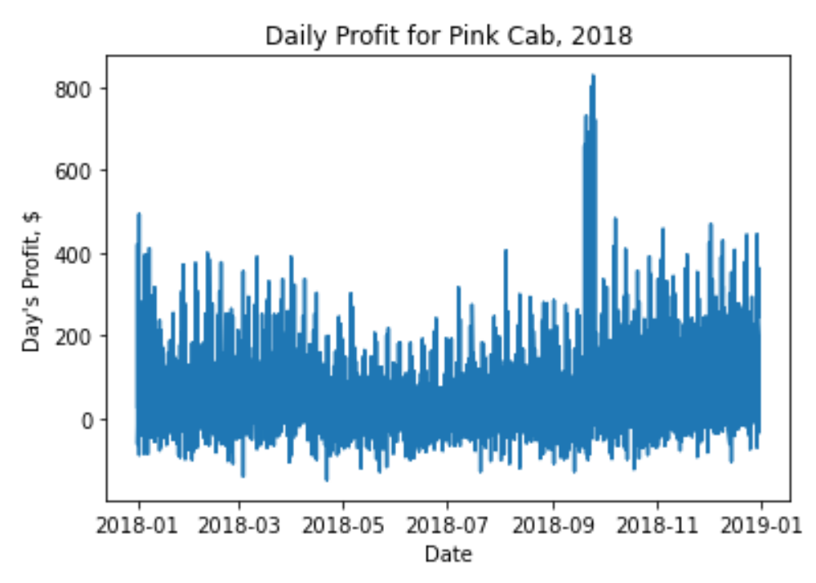
Yellow Cab consistently earns high profit all year. Pink Cab has a profit peak in the fall and lower profit the rest of the year. (Sample year 2018 shown.)

Slide 16
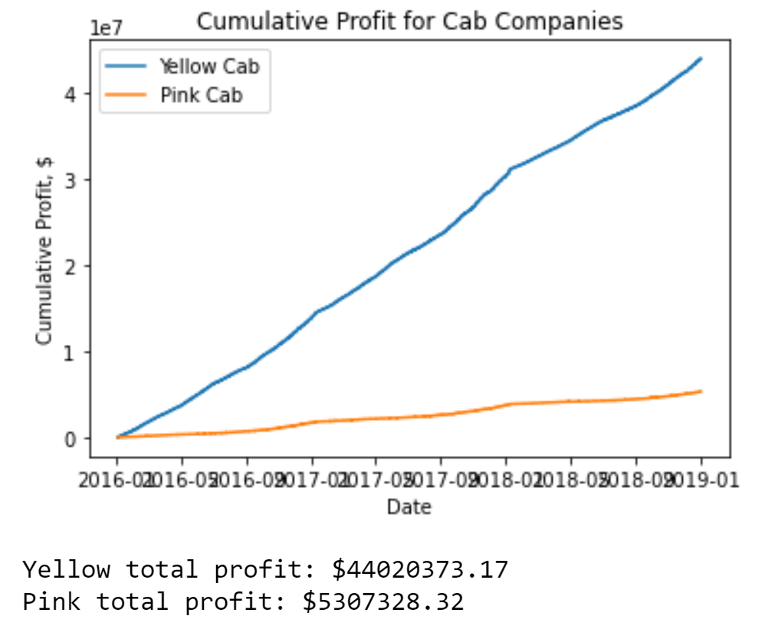
Yellow Cab total profit (3 years): $44M Pink Cab total profit (3 years): $5M

Slide 17
Summary
2 companies have similar customer demographics
Yellow Cab has stronger market penetration in most major US cities
Both have room to expand, especially into San Francisco
Yellow Cab has better customer retention
Despite similar average trip length, Yellow Cab’s trips are more profitable
Yellow Cab has earned nearly 9 times the total profit over 3 years as Pink Cab

Slide 18
Recommendations
1. Invest in Yellow Cab:
Better market penetration
Better customer retention
More profitable
2. Look to expand Yellow Cab into San Francisco, Houston, and other top markets

Slide 19
Thank You

